Slide 1


Data Size by number of rows
Overview of Key
Analytics & Insights
11M+
July 25, 2025 - Data Analytics Case Study BellaBeats Author - Ruben D. Velasco
Stakeholders: Cofounder Sršen, Executive Mur, & Bellabeats Marketing Analytics Team
With focus on one product :
35
Kaggle
App
Data Source Used
Relational
# Users in Study
Database Type Format
Notes:
-For those who like to play I-Spy, I have hidden a heart in each slide for you -Fun fact: The data size is approximately - 11,081,073 rows

Slide 2







The Ask - Business Task & Problem Statement
The Business Task -- analyze smart device data to provide insights to help Bellabeat grow into a larger player in the global smart device market
Problem Statement -- how are users immersing with their smart devices, and which opportunities can Bellabeats capitalize on to enhance their product & services based on this smart device data. Focus place on one from their suite of products, in this case the app. Background at glance:
Spring
Member-ship
Spring Smart Bottler
App
Time
The Bellabeat App
Leaf
The paid subscription
Wellness watch
Wellness tracker
Notes:
90% of time spent and logged comes from sedantry, doing nothing. 69% Users track their sleep. 23 out of the 35 have records. A gap. 33% Users track their heartbeat, only 7 of the 35 users logged data here. Signifies a gap 66% Users missing in weight, only 11 of the 35 users logged data here. Signifies a gap

Slide 3

The Prep - Limitations & Data Detail Review
There are 29 dataset cvs files (11 Million Rows of Data) pulled from Kaggle,
Original Data Source -- https://www.kaggle.com/datasets/arashnic/fitbit
ROCCC
Privacy
The data does meet reliability, original, and cited. The only exceptions are comprehensive and current. This is due to the diminished unique user count in some datasets and outdated entries which are no longer relevant/current
Only data provided with consent of users is used. IDs found in datasets are notated by anonymous numbers and not names.
Format
Data is outdated with entries: 3.12.16 - 4.11.16 & 4.12.16 - 5.12.16
*For this study, analysis is applicable for year 2016.
The data format used here is Long

Slide 4
The Process - Tool Sets & Cleaning
Datasets uploaded to several tools - BigQuery, Excel, Google Sheets, R Project, Tableau, and Gemini Ai. Each tool was chosen to avoid dependency on any given one tool and increased redundancy.
BigQuery
Data Cleaning: All datasets containing “date/time” were separated for BigQuery upload
Google Sheets + Excel
Inspected contents to verify data for columns and rows made sense, no string text where values should be
Gemini Ai & R Project
Ran analysis through Ai & R Project which performed calculations to find mean, min, max, sums, quartiles. Duplicates removed here as well

Slide 5
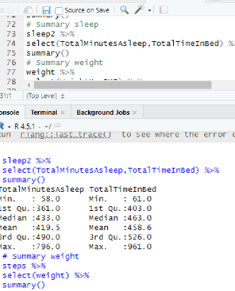
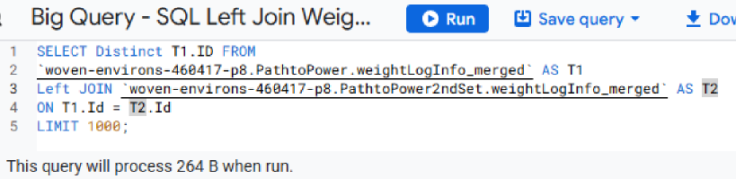

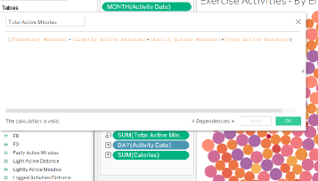
Data Manipulations - Calculations
Examples: BigQuery (SQL) for # Unique IDs in Datasets
R Project for quartiles, mean, median, etc
Tableau for new calculated totals such as Overall Daily Activity
Calculations used to find # of Unique IDs in
weightLogInfo and other datasets - BigQuery (SQL)
BigQuery (SQL) -
SELECT Distinct ID FROM `woven-environs-460417-p8.PathtoPower.weightLogInfo_merged` LIMIT 1000
R Project
Tableau
Highest Mins. Entry in Daily Activity
Tableau - ([Sedentary Minutes]+[Lightly Active Minutes]+[Fairly Active Minutes]+[Very Active Minutes])
Unique IDs in Hourly Intensity
R Project -
intensity <- read.csv("~/Data Analytics Path to Power May 2025/RubensCapstone7.9.25/mturkfitbit_export_3.12.16-4.11.16/Fitabase Data 3.12.16-4.11.16/hourlyIntensities_merged.csv")
head(intensity)
SQL
16 Hrs
Average Seda. Mins
In Daily Act. by Excel & Google Sheets =Average(H5:H44)

Slide 6
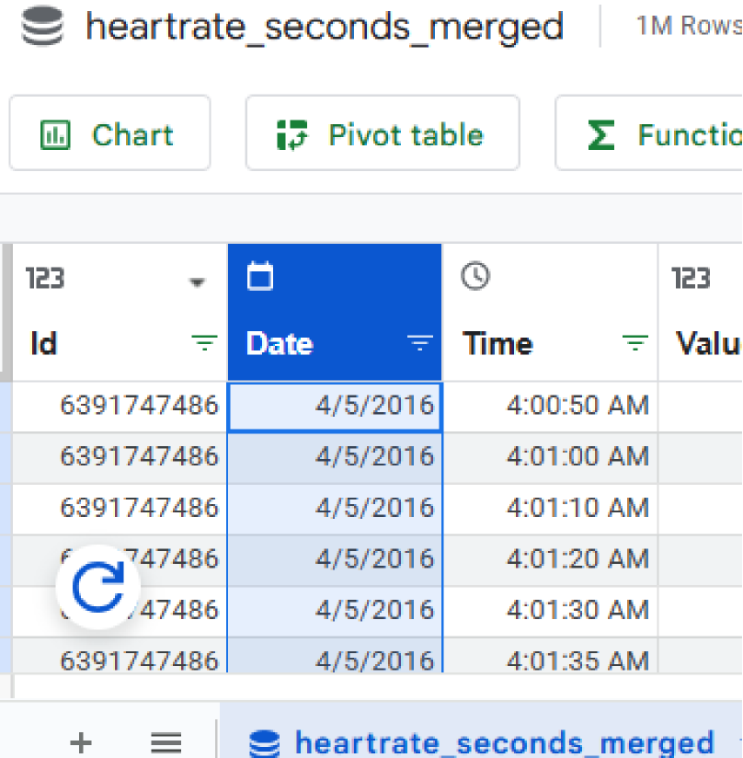
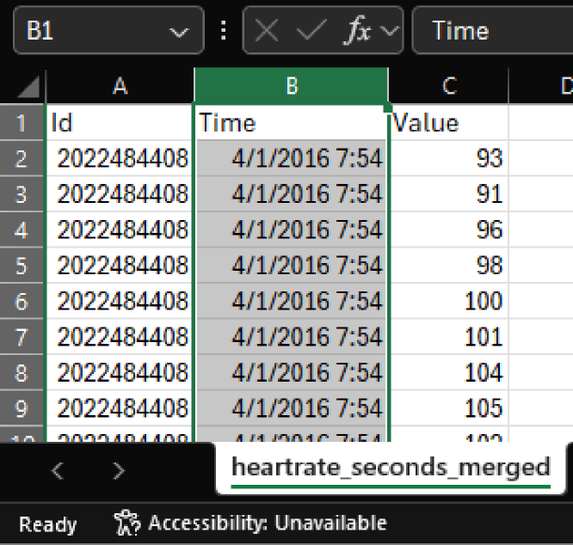

Before & After
Split Text to Column
After saving csv datasets locally, data time column needed to be formatted to be uploaded successfully in BigQuery

Slide 7
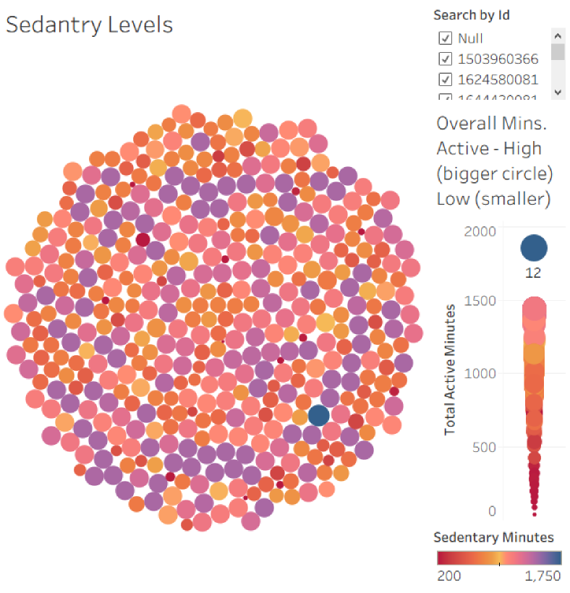

The Analysis - Focus on Trends, Gaps, & Insights
Surprisingly, the most notable trend is the high amount of sedantry minutes (idle) activity across all users. Analyzed using Tableau. For a fitness focused device having this being the single largest outlier metric is alarming.
Sedantary Levels by Hue
Highest Sedantary
The glaring metric is there’s no big red circles, only small ones. This means most of the large amounts consist of idle time
High Sedantry
Moderate
Low

Slide 8
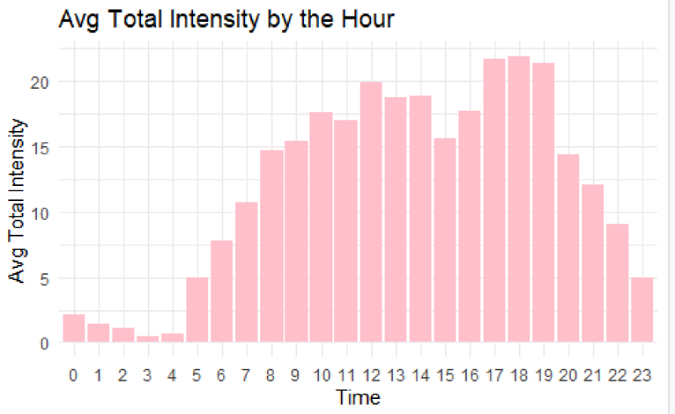
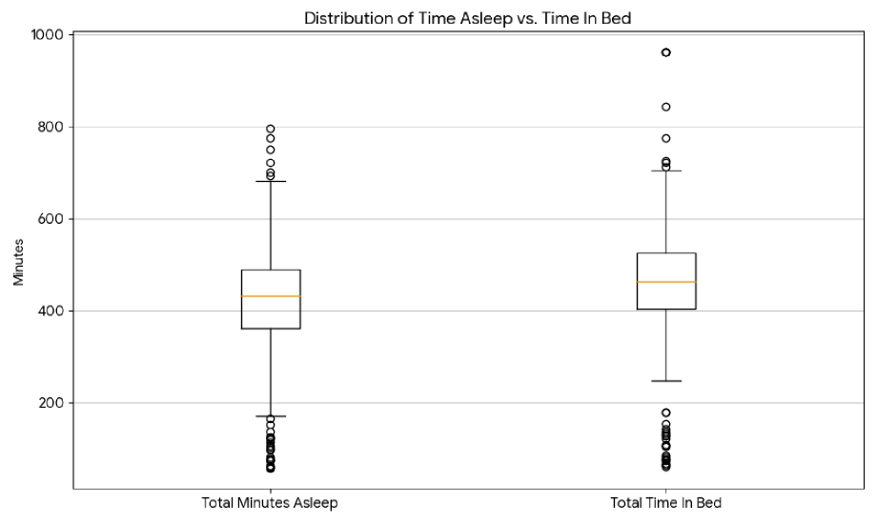
The Analysis Continued - Gaps, Timings, and Insights
For Peak Intensity, relationship exists where consistent user higher activity exists and peak times between 5PM to 7PM. We also see an insight of people on average 7.6 hrs (460 Mins.) in bed, yet only asleep for 7 hrs (420 Mins.) of that time. Surprisingly, there is a high “Time Awake In Bed.” Analyzed using R Project and Gemini Ai, respectively.

Slide 9
Share
990~
Highest Recorded Metrics & Outliers Reveal
Significant Opportunity here. Have the app and smart devices use gentle reminders to move during prolonged idle periods
Sedentary Minutes daily
Peak Usage Trend:
Most in 5 - 7PM window
39~
The app can use these metrics for personalized sleep guidance
Thursday & Saturdays
Relationships exists where Users are most active on Thursdays and Saturdays; Sunday and Monday being lower activity days. Valuable weekly routine insight
Average Minutes Spent Awake in Bed

Slide 10

Share - The Story: How Success in People, Transforms Success in Bellabeats
The key is in the timing. A person has so many things in a day, yet what if they saw the most critical moments, and jumped...
Rather than seeing the moments pass by, Bellabeats too can make the leap forward...
The data does show there critical times for success, that cannot afford to be missed...

Slide 11
Act
What trends & insights does the data show to help market Bellabeats
Bellabeats can grow using the data, users are needing help in...
Current usage reveals what the company can do next
Recommendations: how Bellabeats can leverage their app & marketing

Slide 12
Sleep
Launch Marketing Campaign around “Prime Time”
Better rest
In a holistic partnership with not only exercise, the app can remedy and improve sleeping habits. Promoting “Ready in Bed” Mode. Promoting mindful habits and relaxation exercise in key moments of the night.
Here the app can be used to target reminders, workout routines, and motivational content around the peak periods 5PM to 7PM. As well as Thursdays and Saturdays.
Building up user base, while encouraging success in powerful moments.

Slide 13
Prime Time
Gamify Wrap:
Yearly Wins
2024
In a similar way Spotify Wrap summarizes achievements. Have users gamify their progress to include “sleep” streak” or “sleep score” with overall annual review of significant strides made by the end of the year.
Another action: Bellabeat should integrate heart rate monitoring with stress and mindfulness features too. Notifications can be sent with guided breathing exercises during elevated periods of inactivity.
Gamify
2025
Act now
Position tool for holistic wellness, not just fitness
2026

Slide 14
User Base
Bellabeats users a highly active group with a clear, cyclical routine, make the app part of the routine
BellaBeat Prime
Overview of the App - the new hub
Market a campaign on BellaBeat Prime to capitalize on the key windows (5-7PM)
Making the app central for personalized guidance. Providing also Sleep Quality Score and actionable tips “wind-down routine” as well.
Revise Product Descriptions
Highlight holistic wellness tracking capabilities. Capitalize on stress management and sleep health into fitness

Slide 15

Tableau
Github
Closing Remarks:
Looking Forward
Together
https://github.com/rubeskadoobs/CapStoneDataAnalyticsProject/blob/main/RProjectCapstone.R
https://public.tableau.com/app/profile/ruben.velasco/viz/Capstone_17535696193400/ExerciseActivities-ByEntrying
Google Sheets
Sharing the appendix of where R Project, Tableau, Excel, and Google Sheets are all stored related to the research conducted
https://docs.google.com/spreadsheets/d/e/2PACX-1vSktKtNgDqyumH1Es-Wp7Gj0FplooS4yQ8tnFDcSVbEwPw2udKWJ2T1Z0u-i4DuKqjvNbs3gXgs6Oi5/pubhtml?gid=1732160294&single=true
View More

